Slide 1
LAND USE / LAND COVER CLASSIFICATION USING DEEP LEARNING BASED OPTIMAL FEATURE EXTRACTION AND EVOLUTIONARY FEATURE SELECTION TECHNIQUES
Presented by Mrs. T. Gladima Nisia, (Reg. No. 17244891386) Assistant Professor, Department of Computer Science & Engineering, AAA College of Engineering & Technology, Sivakasi.
Supervisor:
Research Co-ordinator:
Dr. S. Rajesh, Associate Professor (Selection Grade), Dept. of Information Technology, Mepco Schlenk Engineering College (Autonomous), Sivakasi
Dr. J. Raja Sekar, Professor & Head, Dept. of Computer Science and Engg., Mepco Schlenk Engineering College (Autonomous), Sivakasi

Slide 2
INTRODUCTION
The Remote Sensing (RS) image has millions and millions of details hidden in it.
The interpretation of RS images thus leads to a variety of new improvements in the real life.
Since, the RS image coils a lot of areas in a single image, intense care has to be taken while handling each and every pixel.
Revealing the details of every pixel helps in a lot of real-world applications.

Slide 3
(Con’t….)
So, classifying an image is a very useful and important task.
In order to classify an image, it is necessary to extract the features.
Hence, the extraction of features plays an important role. Efficient features thus always increase the accuracy of the classification process.

Slide 4
(Con’t….)
Application of Remote Sensing (RS) image classification
Mapping of Land Use/ Land Cover (LULC),
Agricultural usage,
Obtaining geological information,
Urban & regional planning,
Detection of land area, water resources, etc.

Slide 5
OBJECTIVE AND EXPECTED OUTCOME
Objective:
To extract optimal features from images and use those features for classification.
To identify complex patterns present in the RS image.
To extract different land cover and land use areas without any boundary loss.
To increase the classification accuracy.
Outcomes:
Efficiently classified remote sensing image with clearly identified land cover and land use areas.

Slide 6
PROBLEM DESCRIPTION
The remotely sensed image consists of many land cover and the land use areas.
The land cover area is the earth cover which consist of forest, water, bare land, saline land, mountain range etc.
The land use is the land cover area converted into a built environment such as residential buildings, commercial buildings, transport and agricultural land.
The land cover/ land use has to be identified and classified.

Slide 7
(Con’t…)
The image classification mainly concentrates on the feature extraction process.
The features extracted in an efficient manner will obviously result in the improvement of the classification accuracy.
Hence, the different methods for feature extraction and feature selection is explained.
Finally, the best methodology for feature extraction is adopted and features are extracted and used for the classification process.

Slide 8
LITERATURE SURVEY

Slide 9
Literature Survey based on LISS Images
Journal Name | Dataset | Methodology
Vignesh T, Thyagharajan KK, Murugan D, Sakthivel M, Pushparaj S (2016). A novel multiple unsupervised algorithm for land use/land cover classification. Indian J Sci Technol 9(42):1– 12. | Landsat-8, Liss-3 and AWIFS images – District of Kanyakumari, Tamil nadu, India | Performs both clustering and classification for LULC. Clusters the images into groups using a novel Singular Value Decomposition (SVD) trace function clustering algorithm. The clustered samples are used as training samples for the novel unsupervised Ensemble Minimization Learning algorithm (EML) learning and EML classifies the testing set. It produces classification accuracy of 90.56%. Limitation: The clustering may sometimes results in creating unnecessary group of training samples.

Slide 10
Journal Name | Dataset | Methodology
Amit Kumar Verma, Garg P.K., Hari Prasad K.S, Dadhwal V.K (2016). Classification Of LISS IV Imagery using Decision Tree Methods. The International Archives of the Photogrammetry, Remote Sensing and Spatial Information Sciences, Vol. XLI-B8. | LISS IV Image - Foloda Village located in Muzaffarnagar District, India | Crop classification using an integrated approach methods based on texture feature (mean, variance, kurtosis and skewness) and different vegetation indices (NDVI, DVI, GEMI, GNDVI, MSAVI2, NDWI, NG, NR, NNIR, OSAVI and VI green). Finally, the classification is done using decision tree method. The classification accuracy is 89.42% Limitation: Resulting in low accuracy value.

Slide 11
Journal Name | Dataset | Methodology
Mitkari K.V, Arora M.K and Tiwari R.K (2017). Extraction of Glacial Lakes in Gangotri Glacier Using Object-Based Image Analysis. IEEE Journal of Selected Topics in Applied Earth Observations and Remote Sensing, Vol. 10, no. 12, pp. 5275-5283. | LISS IV Image - Glacial lake present in Indian Himalayas, Uttarkashi district, Uttarakhand State, India | A novel object-based image analysis (OBIA) approach for extraction of Glacial lakes. The segmentation is performed using multi resolution segmentation algorithm to bring out the objects and after segmentation the rule set is defined to classify the object. The misclassification of shadow as lake is avoided. The classification accuracy obtained is 94.83% Limitation: Parameters are dataset dependent so having a universal value is not possible.

Slide 12
Journal Name | Dataset | Methodology
Prakash P.S, Soumya K.D and Bharath H.A (2018). Urban building extraction using satellite imagery through Machine Learning, 2018 IEEE Symposium Series on Computational Intelligence (SSCI), pp. 1670-1675. | LISS IV Image - Bengaluru, Karnataka, India. | The method attempts to validate the SVM method to extract buildings from complex scenes. The multiple kernel function of SVM classifier is used. The results show that the radial basis function performs best with 95.68% when compared with linear, sigmoid and polynomial function. Limitation: Due to complex roof surface, the pool of buildings are not captured well. Major misclassification in open area and roads.

Slide 13
Journal Name | Dataset | Methodology
Biswajit Mondal, Ashis Kumar Saha & Anirban Roy (2019): Mapping mangroves using LISS-IV and Hyperion data in part of the Indian Sundarban, International Journal of Remote Sensing. | LISS IV Image - Lothian Island and Saptamukhi Reserve Forest located in the western part of Sundarban Biosphere Reserve of India. | The method introduced a OBIA method for land cover mapping of mangrove forest. The training samples obtained by Hyperion data are used by Object-based Image Analysis (OBIA) classification . Classification is done by Maximum Likelihood Classifier (MLC) using same set of training samples and evaluated with same set of test samples Accuracy: 75.28% Limitation: Resulting in low accuracy value.

Slide 14
Journal Name | Dataset | Methodology
Jovish John , G. Bindu , B. Srimuruganandam, Abhinav Wadhwa & Poornima Rajan (2020) Land use/land cover and land surface temperature analysis in Wayanad district, India, using satellite imagery, Annals of GIS, 26:4, 343-360. | LISS III Image - Wayanad district, Kerala, India | The method employed Maximum likelihood classification (MLC) technique to categorize land-use areas: water body, paddy field, forest, dense, agricultural crops and built-up area. The accuracy assessment of the method produces overall accuracy of 81.19% and 76.094% for 2004 and 2018 respectively. Limitation: Resulting in low accuracy value.

Slide 15
Journal Name | Dataset | Methodology
Krishna Kumar Perikamana, Krishnachandran Balakrishnan, Pratyush Tripathy (2021). A CNN based method for Sub-pixel Urban Land Cover Classication using Landsat-5 TM and Resourcesat-1 LISS-IV Imagery. Computer Vision and Pattern Recognition. | Landsat-5 TM and LISS IV - Bangaluru and Mumbai of India | CNN for Sub-pixel based Urban land cover classification. By calculating Enhanced Built-Up and Bareness Index (EBBI) ratio, the system merges the information from band 6 with the band 5. The EBBI is a widely used remote sensing index which effectively discriminates built-up and bare land areas. The classification accuracy of each class ranges between 89% to 94%. Limitation: System is designed for only estimating built-up and vegetation areas.

Slide 16
Journal Name | Dataset | Methodology
Tanya Jain, MOHD Jawed Khan, Shubham Pandey, Shivam Mishra, Shubham Yadav (2022). Satellite Image Classification and Analysis using Machine Learning with ISRO LISS IV. International Research Journal of Engineering and Technology (IRJET), Vol. 09, no. 5, pp. 1479–1487. | 25 LISS IV satellite imagery dataset from the Space Net dataset | The CNN is employed for detecting objects in the LISS IV. The feature extraction and object recognition is done using CNN. The system attains accuracy between 90 to 95 Percentage. Limitation: Only classes like landmass, waterbody, and forests are detected.

Slide 17
Literature Survey based on Feature Extraction
Journal Name | Dataset | Methodology
Zhouhan Lin, Yushi Chen, Xing Zhao & Gang Wang (2013), ‘Spectral-spatial classification of hyperspectral image using autoencoders’, 9th International Conference on Information, Communications & Signal Processing (ICICS) | Agricultural area of Kennedy Space center with 13 classes and 224 spectral channels. Urban area of Pavia city in the land of Italy with 9 classes and 103 spectral channels. | Autoencoders for extracting the features in an unsupervised manner. The single-layer autoencoder is employed for shallow feature extraction and multi-layer stacked autoencoder is employed for deep features of HSI. Feature extraction method for spectral-spatial representation of HSI for the image classification. Produces an error rate of 4% for the first dataset and 14.35% for the second dataset. Limitation: Maximum Error rate for certain datasets

Slide 18
Journal Name | Dataset | Methodology
Chen, Y, Lin, Z, Zhao, X, Wang, G & Gu, Y (2014), ‘Deep learning-based classification of hyperspectral data’, IEEE J. Sel. Topics Appl. Earth Observ. Remote Sens., vol. 7, no. 6, pp. 2094-2107. | Agricultural area of Kennedy Space center and urban area of Pavia city in the land of Italy. | The single-layer autoencoder is employed for shallow feature extraction and multi-layer stacked autoencoder is employed for deep features of HSI. The system forms a joint spectral–spatial classification framework. The special framework is a hybrid system of deep learning architecture, PCA, and logistic regression. The proposed SAE-LR produces higher classification accuracies for hidden layers of 4 to 6 layer depth and 20 to 60 hidden units per layer.

Slide 19
Journal Name | Dataset | Methodology
Yue, J, Zhao, W, Mao, S & Liu, H 2015, ‘Spectral–spatial classification of hyperspectral images using deep convolutional neural networks’, Remote Sens. Lett., vol. 6, no. 6, pp. 468-477. | Image scene of 610 × 340 pixels cover over the Pavia city in Italy. | The work includes Principal Component Analysis (PCA), DCNN, and logistic regression classification. The system introduces a deep learning based framework with joint spectral–spatial features for classification of HSI. Initially, the feature maps of spectral and spatial are generated. Then the high-level features are obtained using DCNNs-LR (Deep Convolutional Neural Networks - Logistic Regression). Finally, the voting is done and the majority of votes are considered for class value assignment. The system produces OA of 95.18% Limitation: Class level performance is lower for most of the classes in comparison with earlier methods

Slide 20
Journal Name | Dataset | Methodology
Hu, W, Huang, Y, Wei, L, Zhang, F & Li, H 2015, ‘Deep convolutional neural networks for hyperspectral image classification’, J. Sensors, vol. 2015, Article No. 258619 | Indian Pines, Salinas, and University of Pavia scene | In the system proposed by, in order to abstract the features of HSI based on spectral perspective, a five-layer deep CNN has been used, thus leading to improvised classification performance. It produces classification accuracy of 90.16%, 92.60% and 92.56% for Indian Pines dataset, Salinas dataset and Pavia dataset, respectively. Limitation: The spatial correlation are not considered, only the spectral signatures are concentrated.

Slide 21
Journal Name | Dataset | Methodology
Aptoula, E, Ozdemir, MC & Yanikoglu, B 2016, ‘Deep learning with attribute profiles for hyperspectral image classification’, IEEE Geosci. Remote Sens. Lett., vol. 13, no. 12, pp. 1970-1974 | Urban area of Pavia University and Pavia Centre hyperspectral data sets. | Another different combination with CNN depends on the blend of morphological profiles for feature extraction of HSI. The system introduces the way of inputting the CNN using stacked attribute filtered image. It provides a combined strategy of Attribute profile and CNN usage and thus leading to more effective pixel description. The system produces the best efficient results.

Slide 22
Journal Name | Dataset | Methodology
Yushi Chen, et al., (2017), ‘Hyperspectral images classification with gabor filtering and convolutional neural network’, IEEE Geoscience and Remote Sensing Letters, vol. 14, no. 12, pp. 2355-2359, DOI: 10.1109/LGRS.2017.2764915. | Data sets captured over Salinas Valley, a site over the Kennedy Space Center (KSC), and a mixed vegetation site in Indian Pines. | The system combined the features from DCNN with Gabor features. It uses Gabor filtering technique to extract edges and textures and thus helps in feature extraction. The Gabor filters and convolutional filters are combined to overcome the problem of overfitting. To further make the efficiency better, the neural networks are included with ReLU, dropout, and batch normalization. The system provides competitive classification accuracies even when there are limited training samples.

Slide 23
Journal Name | Dataset | Methodology
Felix Juefei-Xu, Vishnu Naresh Boddeti & Marios Savvides 2017, ‘Local binary convolutional neural networks’, IEEE Conference on Computer Vision and Pattern Recognition, pp. 4284-4293, DOI: 10.1109/CVPR. 2017.456. | MNIST, CIFAR-10, SVHN, and ImageNet | The system combines the deep features with LBP features. The system introduces Local Binary Convolution (LBC), which acts as a substitute to the CNN’s convolution layer. The LBC is designed based on the principle of LBP. CNNs constructed using LBC layers are called Local Binary Convolutional Neural Networks (LBCNN). Also, the system performs significant computational savings.

Slide 24
Journal Name | Dataset | Methodology
Zhou, Z, Li, S & Shao, Y 2018, ‘Crops classification from sentinel-2A multi-spectral remote sensing images based on convolutional neural networks’, IGARSS 2018 - 2018 IEEE International Geoscience and Remote Sensing Symposium, pp. 5300-5303, DOI : 10.1109/IGARSS. 2018.8518860. | Sentinel-2A of Yuanyang county belonging to China. | In order to prove the efficiency of high level features extracted from CNN, the system compared the classification methods of CNN and Support Vector Machines (SVM) in extracting the spatial distribution of crops planting area. The system has shown the classification accuracy of 95.6% for CNN and 94.94% for SVM method. Thus, it is clearly understood that the CNN works better than SVM. Limitation: Only spectral information of crops are considered. The spatial information is not considered

Slide 25
Journal Name | Dataset | Methodology
Jiang, J, Feng, X, Liu, F, Xu, Y & Huang, H 2019, ‘Multi-spectral RGB-NIR image classification using double-channel CNN’, IEEE Access, vol. 7, pp. 20607-20613, DOI: 10.1109/ACCESS.2019.2896128. | SAT-4, RGB-NIR, and SAT-6 dataset that is available as open source dataset. | Double-channel CNN algorithm for considering the strong correlation among the R band, G band, and B bands while there is weaker correlation between the NIR band and the RGB band. The RGB and NIR bands based features are calculated using two CNN architecture. The extracted features are associated with fully connected layer and final output is obtained.

Slide 26
Journal Name | Dataset | Methodology
Shengjie Liu, Qian Shi & Liangpei Zhang 2020, ‘Few-shot hyperspectral image classification with unknown classes using multitask deep learning’, IEEE Transactions on Geoscience and Remote Sensing, vol. 59, no. 6, pp. 5085-5102, DOI: 10.1109/TGRS.2020.3018879. | Salinas data | A method named multitask deep learning method with unknown classes in the open world (MDL4OW) was framed for HSI Classification with Unknown classes. The system performs both classification and reconstruction where unknown classes may exist. The system can identify unknown classes while improving classification accuracy. The unknown score is calculated using the model EVT (Extreme Value Theory) and increases the accuracy. Limitation: If a data set lacks basic land cover class then performs well else it is difficult.

Slide 27
Journal Name | Dataset | Methodology
Akrem Sellami & Salvatore Tabbone 2022, ‘Deep neural networks-based relevant latent representation learning for hyperspectral image classification’, Pattern recognition, vol. 121 | Salinas, Indian Pines, and Pavia University datasets. | The system with multi-view deep neural networks was introduced using Deep neural networks-based relevant latent representation learning. Initially, the spatial and spectral features are extracted. Second, the multi-view deep autoencoder model is employed to fuse the spectral features and spatial features to form a joint latent feature. Finally, the fused latent features are used to train the semi-supervised graph CNN for classification. The classification accuracy is also improved even with the less labelled samples. Limitation: Can’t be applied with few labelled training samples.

Slide 28
RESEARCH OBJECTIVE

Slide 29
The key goal of the proposed system is to extract the most efficient optimal features and to perform LULC classification for LISS IV image.
Design a feature extraction method using Ensemble of Object based Textural Features and Deep Features method. The features extracted using the object-based strategy along with deep features from CNN produces efficient features for classification process.

Slide 30
Design a feature extraction method, using a Two-stage textural feature method. The obtained feature set with Gabor feature, RLBP feature and deep features are used in classification accuracy.
Design a feature selection technique by an ensemble of feature aggregation and feature selection methods from the extracted feature set. The optimal features selected can bring out high accuracy values with low features resulting in less computational effort.

Slide 31
STUDY AREA

Slide 32
Dataset used is Madurai Image from LISS IV (Linear Imaging and Self Scanning Sensor) of the Indian Remote Sensing Satellite P6 version.
Data is collected from Madurai city with a coverage of 2.35km X 2.35km from the Tamil Nadu state of India.
For the land cover classification of the Madurai district, the Ground Control Points (GCPs) are collected. E-Trex venture global positioning system device was used to generate a reference dataset for testing the performance of the system.
Notes:
Leaky Relu:
A leaky ReLU layer performs a threshold operation, where any input value less than zero is multiplied by a fixed scalar.

Slide 33
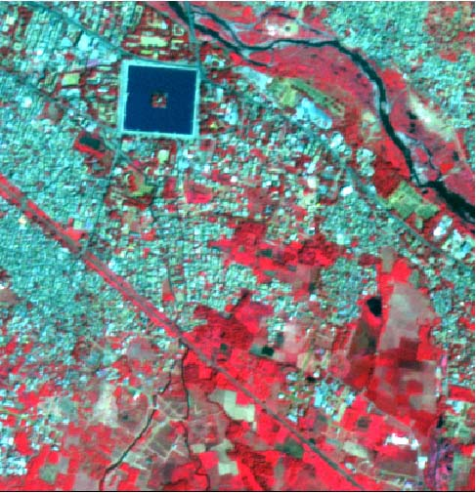
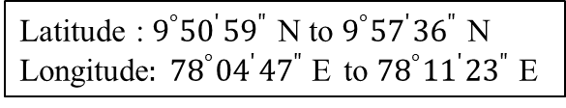
Figure 1. Madurai LISS IV image
Latitude : $9^{°}{50}^{′}{59}^{"}$ N to $9^{°}{57}^{′}{36}^{"}$ N
Longitude$: {78}^{°}{04}^{′}{47}^{"}$E to ${78}^{°}{11}^{′}{23}^{"}$E
Notes:
Leaky Relu:
A leaky ReLU layer performs a threshold operation, where any input value less than zero is multiplied by a fixed scalar.

Slide 34
OUTPUT EVALUATION
PARAMETERS

Slide 35
A confusion matrix (or error matrix) is used as the quantitative method of characterising image classification accuracy. It is a table that shows correspondence between the classification result and a reference image.
The accuracy indices through which the proposed system is going to be evaluated are :
User Accuracy (UA)
Producer Accuracy (PA)
Kappa Coefficient (KC)
Overall Accuracy (OA)

Slide 36
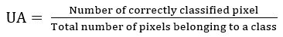
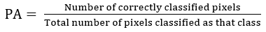
User Accuracy (UA):
Accuracy from the view point of a map user and not the producer. It represents how many classes on the map is actually present on the ground and is denoted as reliability.
Producer Accuracy (PA):
Accuracy from the view point of the producer (map maker). It represents how many ground features are correctly classified or the probability of certain land area on the earth surface is classified in a right manner.

Slide 37
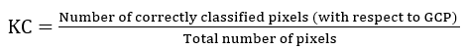
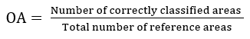
Kappa Coefficient (KC):
KC is the accuracy calculation based on the field visit data. KC value ranges from [-1 1].
Overall Accuracy (OA):
OA is to calculate how many pixels are correctly classified out of all of the reference sites.

Slide 38
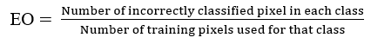
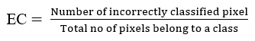
Error of Omission (EO):
EO denotes the reference sites that are omitted from the correct class in the classified map.
Error of Commission (EC):
Errors of Commission (EC) are calculated by reviewing the classified sites for incorrect classifications.

Slide 39
PROPOSED SYSTEM

Slide 40
The modules implemented in the proposed system are as follows:
Feature Extraction Using Ensemble of Object based Textural Features and Deep Features
Feature Extraction Using Two-Stage Textural Feature Method with Convolutional Neural Network
Optimal Feature Selection Using Enhanced Selective Deep Feature Basket-based Firefly Method

Slide 41
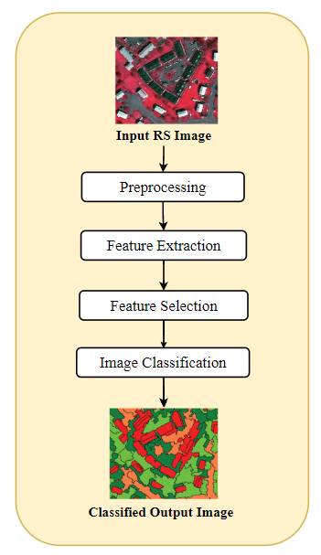
Figure 2. General Flow of Image Classification

Slide 42
FEATURE EXTRACTION USING ENSEMBLE OF OBJECT BASED TEXTURAL FEATURES AND DEEP FEATURES (EOTFDF)
Module - 1

Slide 43
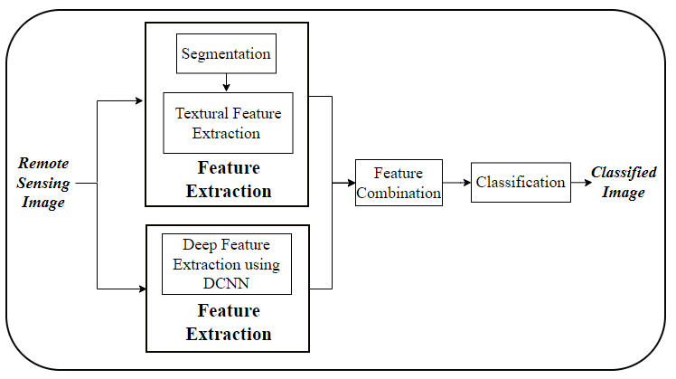
Figure 3. Flow diagram of EOTFDF method
Notes:
Local Feature:
Local features are particularly capable of attending to local image patterns or textures.

Slide 44
1.1 Object-based Segmentation
The segmentation process works by grouping similar regions while preserving the information present near boundaries.
The system employs the Multi-resolution segmentation algorithm.
Important properties to be considered are shape, scale, and compactness.
Notes:
Local Feature:
Local features are particularly capable of attending to local image patterns or textures.

Slide 45
The process of multiresolution image segmentation resembles like a region merging process.
Every pixel is taken as an image object.
The merging is based on the concept of local homogeneity and works based on the adjacent image object’s similarity.
It results in obtaining larger image objects.
Notes:
Local Feature:
Local features are particularly capable of attending to local image patterns or textures.

Slide 46
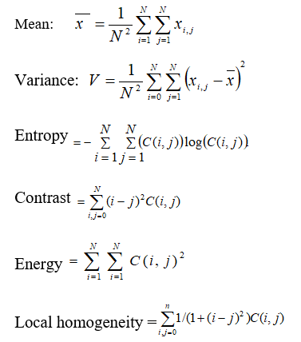
1.2 Feature Extraction
Notes:
Local Feature:
Local features are particularly capable of attending to local image patterns or textures.

Slide 47
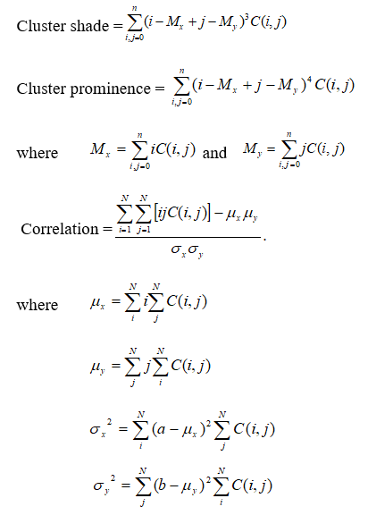
(Con’t…)
Notes:
Local Feature:
Local features are particularly capable of attending to local image patterns or textures.

Slide 48
1.3 Deep Features
Deep Feature is obtained using the Convolutional Neural Network architecture.
It works by applying n-number of convolution operations followed by pooling operations.
At the end, it results in generation of feature maps.
CNN
Notes:
Local Feature:
Local features are particularly capable of attending to local image patterns or textures.

Slide 49
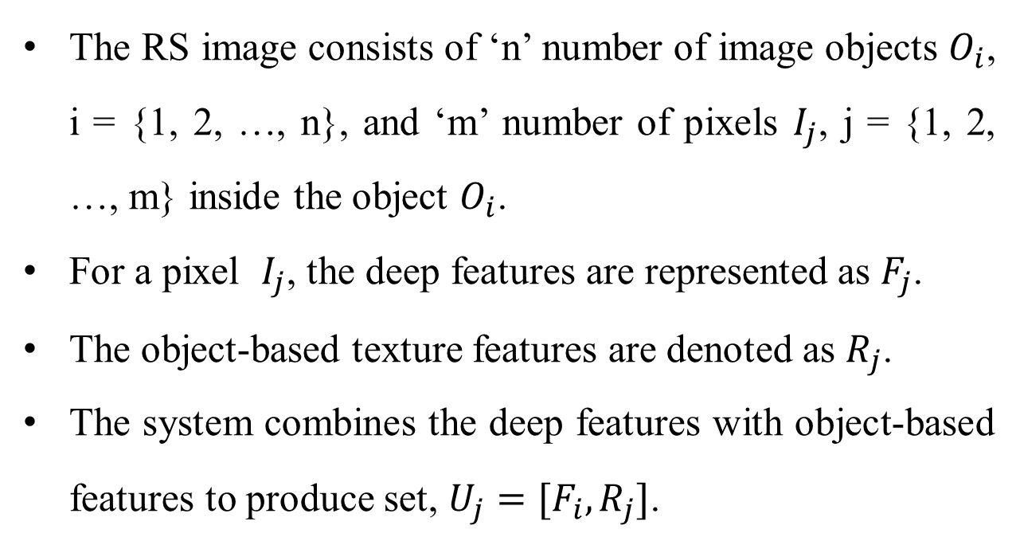
1.4 Object-based classification
The RS image consists of ‘n’ number of image objects $O_{i}$, i = {1, 2, …, n}, and ‘m’ number of pixels $I_{j}$, j = {1, 2, …, m} inside the object $O_{i}$.
For a pixel $I_{j}$, the deep features are represented as $F_{j}$.
The object-based texture features are denoted as $R_{j}$.
The system combines the deep features with object-based features to produce set, $U_{j}=[F_{i},R_{j}]$.
Notes:
Local Feature:
Local features are particularly capable of attending to local image patterns or textures.

Slide 50
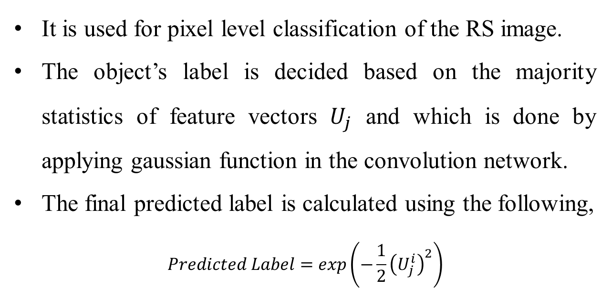
It is used for pixel level classification of the RS image.
The object’s label is decided based on the majority statistics of feature vectors $U_{j}$ and which is done by applying gaussian function in the convolution network.
The final predicted label is calculated using the following,
$$Predicted Label=exp\left(−\frac{1}{2}{\left(U_{j}^{i}\right)}^{2}\right)$$
Notes:
Local Feature:
Local features are particularly capable of attending to local image patterns or textures.

Slide 51
EXPERIMENTAL RESULTS AND DISCUSSIONS

Slide 52
Hyperparameters setting for CNN

Slide 53
The analyses are done for all the hyperparameters except the “Maximum Number of Epoch”.
The Number of Epoch is analysed for every module individually.
For the analysis, the number of epoch is set as 50 and the number of feature maps as 20.
The system employs stochastic gradient descent optimization algorithm for its training.
The whole process is tested with the LISS IV Madurai image dataset.
Notes:
Local Feature:
Local features are particularly capable of attending to local image patterns or textures.

Slide 54
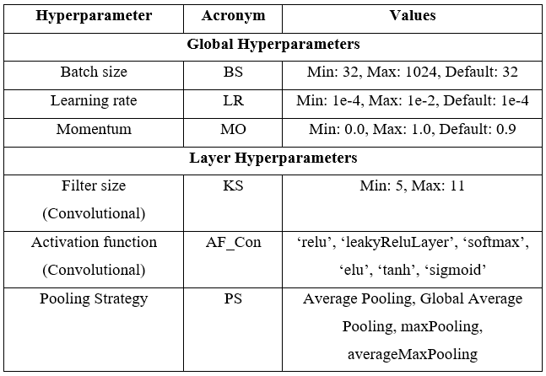
Table 1. Hyperparameter and its values
(The CNN hyperparameters range and value for optimization are chosen based upon the work of Fatyanosa & Aritsugi (2020)).
Notes:
Local Feature:
Local features are particularly capable of attending to local image patterns or textures.

Slide 55
Mini-batch Size
A mini-batch is a subset of training set and by using which, the gradient of the loss function is evaluated as well as the weights are updated.
It is used during each training iteration as positive integer.
If the selected batch size doesn’t divide the number of training samples evenly, then the training data that are unfit into the final complete mini-batch of each epoch, are rejected.
Notes:
Local Feature:
Local features are particularly capable of attending to local image patterns or textures.

Slide 56
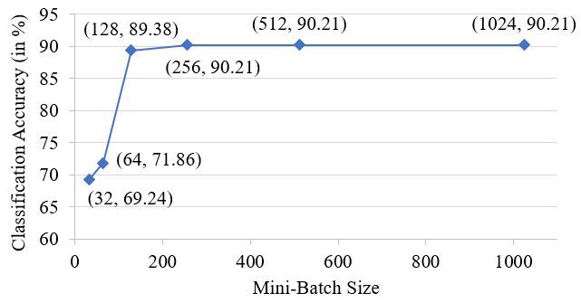
Analyzing the change in mini-batch Size
Figure 4. Effect of mini-batch size
Notes:
Local Feature:
Local features are particularly capable of attending to local image patterns or textures.

Slide 57
Learning rate
Learning rate refers to how big or small the changes in weights are after each optimization step.
The learning rate is a hyperparameter which can control the amount of change in the model to correct the estimated error, as the model weights get updated.
The choice of the learning rate must be done carefully, as the selection of too smaller value leads to a long training process, thus getting stuck. Also, it requires more training epochs.
Notes:
Local Feature:
Local features are particularly capable of attending to local image patterns or textures.

Slide 58
Similarly, the choice of too larger value results in too fast learning of sub-optimal set of weights or results in an unstable training process.
It results in rapid changes and requires fewer training epochs.
Thus, the suboptimal solution is obtained too quickly and the model converges too quickly.
Notes:
Local Feature:
Local features are particularly capable of attending to local image patterns or textures.

Slide 59
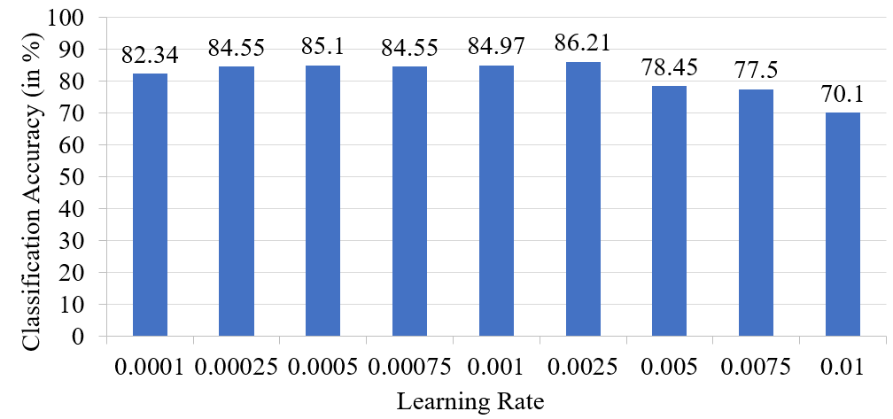
Analyzing the change in Learning rate
Figure 5. Effect of learning rate
Notes:
Local Feature:
Local features are particularly capable of attending to local image patterns or textures.

Slide 60
Momentum
Momentum represents the acceleration of convergence during the optimization process of gradient-based methods.
It has been intended to accelerate the learning in the low curvature direction and not to move in high curvature direction and become unstable.
The main idea is to calculate the exponentially weighted average of the gradients and then, to update the weights based on the gradient.
Notes:
Local Feature:
Local features are particularly capable of attending to local image patterns or textures.

Slide 61
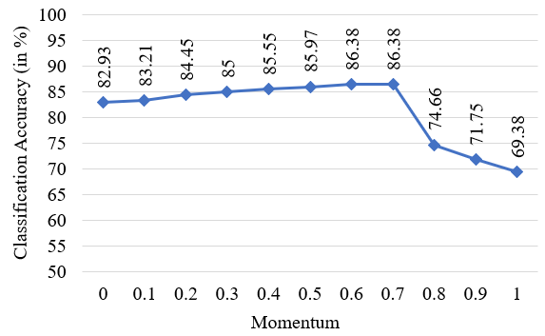
Analyzing the change in Momentum
Figure 6. Effect of Momentum
Notes:
Local Feature:
Local features are particularly capable of attending to local image patterns or textures.

Slide 62
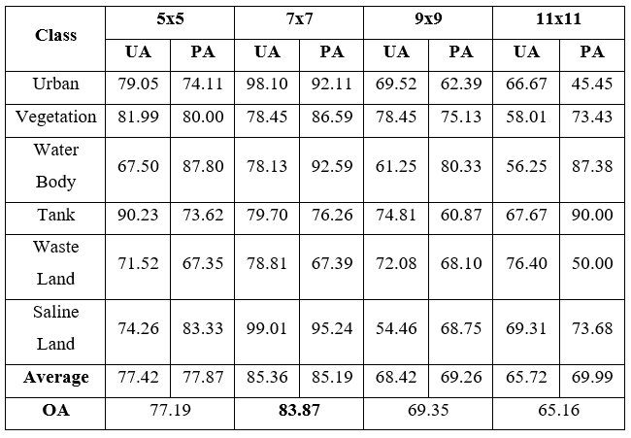
Analyzing the change in Filter size
Table 2. Performance of the model by varying the filter size
Notes:
Local Feature:
Local features are particularly capable of attending to local image patterns or textures.

Slide 63
Activation functions
The activation function decides whether a neuron should be activated or not.
These activation functions are applied in hidden layer and output layer of CNN.
The activation function found in hidden layer controls how efficiently the model learns the training dataset.
The activation function found in the output layer will define the predictions of the model.
Notes:
Local Feature:
Local features are particularly capable of attending to local image patterns or textures.

Slide 64
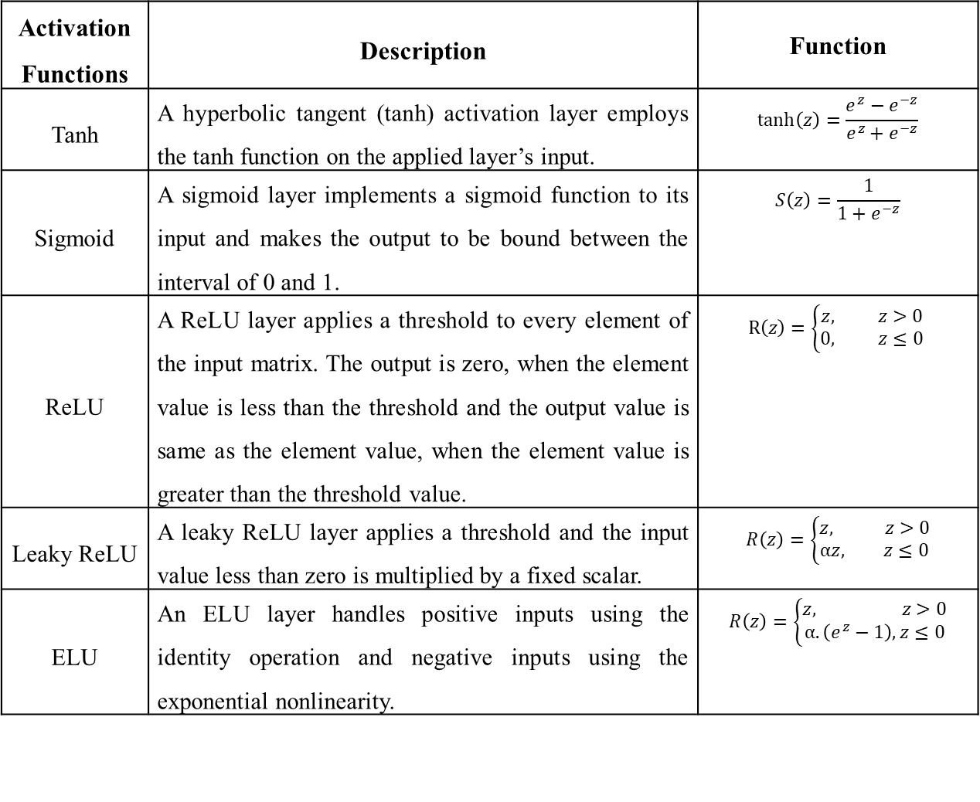
Table 3. Different activation functions
Activation Functions | Description | Function
Tanh | A hyperbolic tangent (tanh) activation layer employs the tanh function on the applied layer’s input. | $$\tanh\left(z\right)=\frac{e^{z}−e^{−z}}{e^{z}+e^{−z}}$$
Sigmoid | A sigmoid layer implements a sigmoid function to its input and makes the output to be bound between the interval of 0 and 1. | $$S\left(z\right)=\frac{1}{1+e^{−z}}$$
ReLU | A ReLU layer applies a threshold to every element of the input matrix. The output is zero, when the element value is less than the threshold and the output value is same as the element value, when the element value is greater than the threshold value. | $$R\left(z\right)=\left\{\begin{aligned}z, z>0 \\ 0, z≤0\end{aligned}\right.$$
Leaky ReLU | A leaky ReLU layer applies a threshold and the input value less than zero is multiplied by a fixed scalar. | $$R\left(z\right)=\left\{\begin{aligned}z, z>0 \\ αz, z≤0\end{aligned}\right.$$
ELU | An ELU layer handles positive inputs using the identity operation and negative inputs using the exponential nonlinearity. | $$R\left(z\right)=\left\{\begin{aligned}z, z>0 \\ α.\left(e^{z}−1\right), z≤0\end{aligned}\right.$$
Notes:
Local Feature:
Local features are particularly capable of attending to local image patterns or textures.

Slide 65
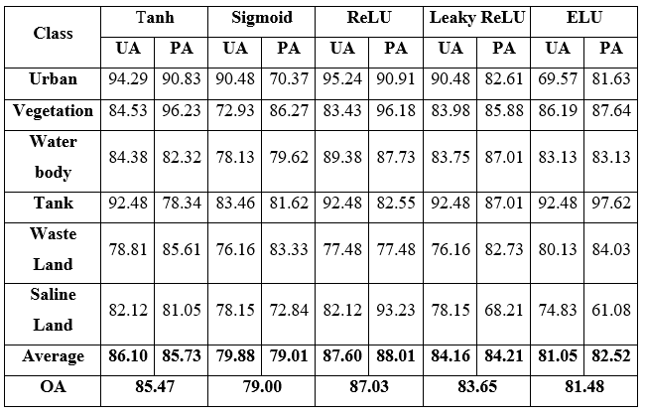
Analyzing the change in activation functions
Table 4. Performance of the model by varying the activation function
Notes:
Local Feature:
Local features are particularly capable of attending to local image patterns or textures.

Slide 66
Pooling strategies
The pooling operation is done by sliding a 2D filter over every channel of the feature map.
The features covered under this 2D filter are summarized and brought as a single value.
The next processing is done on the summarized features.
The feature map dimensions are greatly reduced.
The computations and the learnable parameters in the neural network are reduced.
The model becomes stronger to variations in the feature position in the input image.
Notes:
Local Feature:
Local features are particularly capable of attending to local image patterns or textures.

Slide 67
Table 5. Performance of the model by varying the pooling strategy
Pooling Strategy | Description
Average Pooling | Downsampling is performed by dividing the input into rectangular pooling regions and then, each region’s average is calculated.
Global Average Pooling | Downsampling is performed by calculating the average of the input.
Max Pooling Layer | Downsampling is performed by dividing the input into rectangular pooling regions and then, each region’s maximum is calculated.
Global Max Pooling | Downsampling is performed by calculating the maximum of the input.
Notes:
Local Feature:
Local features are particularly capable of attending to local image patterns or textures.

Slide 68
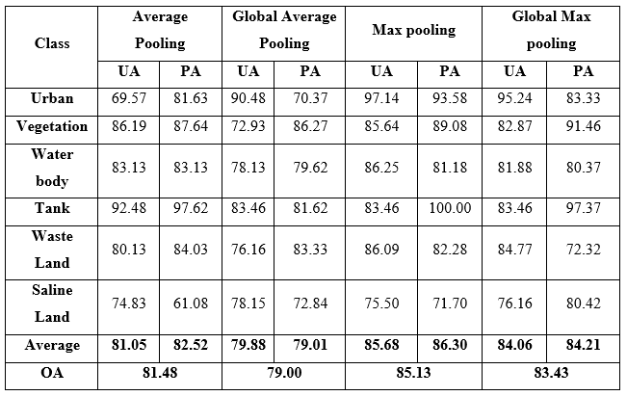
Analyzing the change in pooling strategies
Table 6. Performance of the model by varying the pooling strategy
Notes:
Local Feature:
Local features are particularly capable of attending to local image patterns or textures.

Slide 69
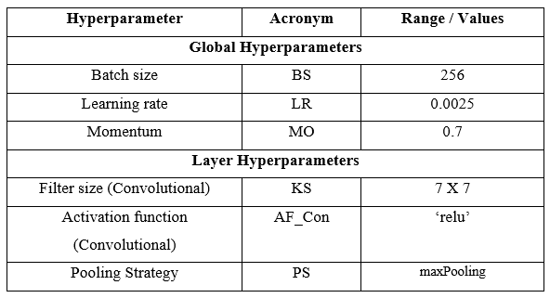
Table 7. Optimized hyperparameter values
Notes:
Local Feature:
Local features are particularly capable of attending to local image patterns or textures.

Slide 70
EXPERIMENTAL RESULTS

Slide 71
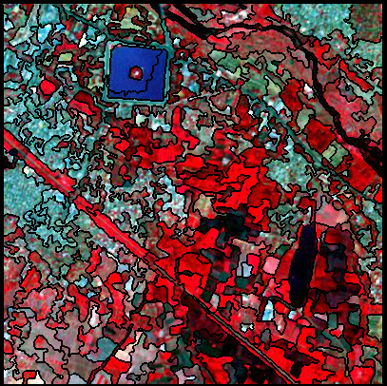
Figure 7.
Segmented Image of LISS IV Madurai Image
Notes:
Local Feature:
Local features are particularly capable of attending to local image patterns or textures.

Slide 72
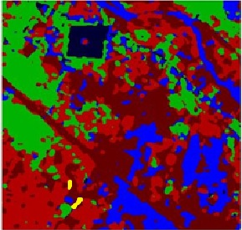
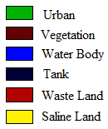
(Con’t…)
Figure 8.
Classified Output Image of LISS IV Madurai Image
Notes:
Local Feature:
Local features are particularly capable of attending to local image patterns or textures.

Slide 73
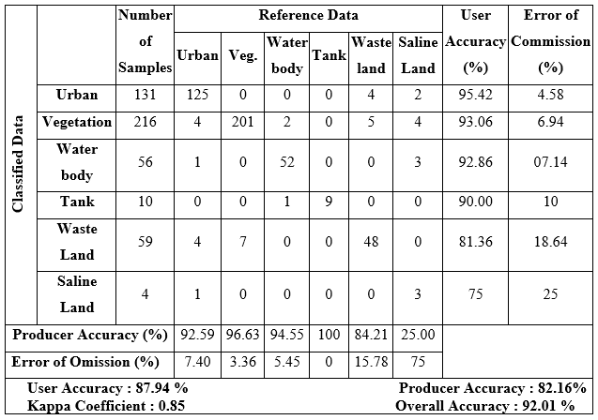
Table 8. Confusion Matrix for Madurai Image
Notes:
Local Feature:
Local features are particularly capable of attending to local image patterns or textures.

Slide 74
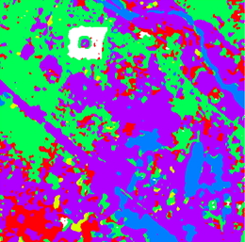
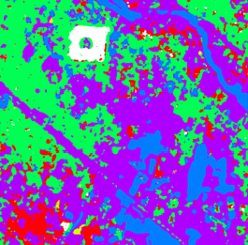
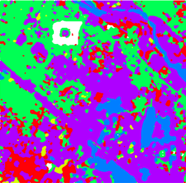
(Con’t…)
(a)
(b)
(c)
(d)
Figure 9.
Classification results of different methods for Madurai Image a. EOTFDF b. Daubechies2 (DB2) c. DB2 with GA and ANN, d. DB2 with GA and ANFIS
Notes:
Local Feature:
Local features are particularly capable of attending to local image patterns or textures.

Slide 75
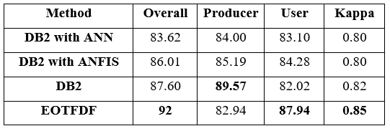
(Con’t…)
Table 9.
Results of different methods and their classification accuracies for Madurai Image
Notes:
Local Feature:
Local features are particularly capable of attending to local image patterns or textures.

Slide 76
FEATURE EXTRACTION USING TWO-STAGE TEXTURAL FEATURE METHOD WITH CONVOLUTIONAL NEURAL NETWORK
Module - 2

Slide 77
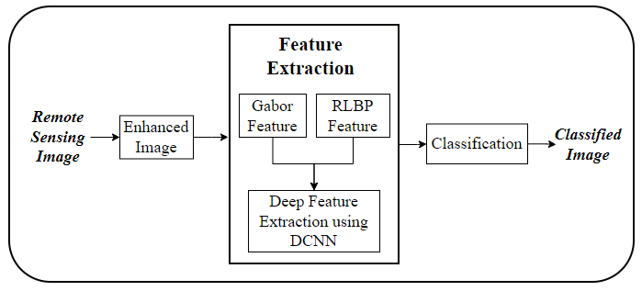
Figure 10.
System architecture of the Proposed System
Notes:
Local Feature:
Local features are particularly capable of attending to local image patterns or textures.

Slide 78
2.1 Pre-Processing using Image Enhancement
Main purposes of image enhancement are:
Increasing contrast
Emphasizing edges
Preserving Colour.
The proposed system applies bilateral filter to attain the detail image.
Notes:
Local Feature:
Local features are particularly capable of attending to local image patterns or textures.

Slide 79
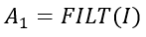
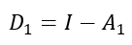
The image is decomposed into L detail image with L detail layer.
In obtaining detail image, initially the approximation image is obtained by applying the following,
The detail image is found by calculating the difference between the input image and approximation image.
Notes:
Local Feature:
Local features are particularly capable of attending to local image patterns or textures.

Slide 80
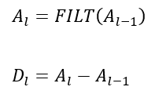
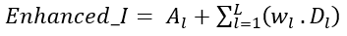
The approximation layers are applied with the same filters. The next level of detail image is attained using the following,
The final enhanced image is attained by adding the output of final approximation layer and detail layer.
Notes:
Local Feature:
Local features are particularly capable of attending to local image patterns or textures.

Slide 81
2.2 Feature Extraction
The proposed method uses the following methods for extracting features:
Feature extraction using Gabor Filter
Feature extraction using RLBP method
Deep feature extraction using DCNN.
Notes:
Local Feature:
Local features are particularly capable of attending to local image patterns or textures.

Slide 82
2.2.1 Feature extraction using Gabor Filter
Gabor filter is a filter with multi-scale and multi-direction.
The filters help in capturing the spatial domain’s orientation and frequency representation.
To get informative features, the system applies different frequencies and directions.
Notes:
Local Feature:
Local features are particularly capable of attending to local image patterns or textures.

Slide 83
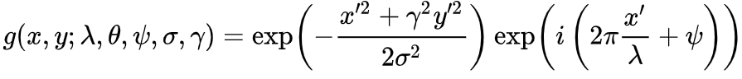
The Gaussian kernel function is used to define these parameters. Then the frequency content in a particular direction, (For instance, in a localized area like point or region) is analysed.
Where,
Notes:
Local Feature:
Local features are particularly capable of attending to local image patterns or textures.

Slide 84
λ - Wavelength of the sinusoidal factor,
Ѳ - Orientation of the normal to the parallel stripes of a Gabor function,
Ф - Phase offset,
σ - Standard deviation of the Gaussian envelope and
γ - Spatial aspect ratio, and specifies the ellipticity of the support of the Gabor function
By varying ѳ, the texture variation of a specific direction can be analyzed.
The Gaussian kernel convolution around the image, is denoted by ‘i’ and ‘j’ to represent the vertical and horizontal dimensions.
Notes:
Local Feature:
Local features are particularly capable of attending to local image patterns or textures.

Slide 85
2.2.2 Feature extraction using RLBP Filter
Step 1: For a single pixel, consider all the neighbour values of that pixel and construct a neighbour pixel matrix (NPM) which is a 3×3 matrix. The NPM has 9 values. (Figure 11(a))
Step 2: Calculate mean value of NPM
Step 3: Compare each value in the NPM with the mean value and construct another binary NPM (BNPM). The BNPM has the value ‘1’ if pixel value exceeds mean value and else its ‘0’. (Figure 11(b))
Notes:
Local Feature:
Local features are particularly capable of attending to local image patterns or textures.

Slide 86
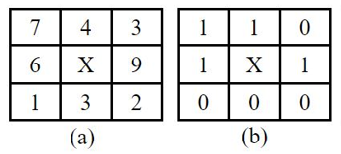
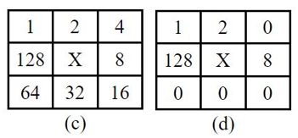
Figure 11.
(a) NPM matrix (b) BNPM Matrix (c) RM matrix (d) Resultant Matrix
Notes:
Local Feature:
Local features are particularly capable of attending to local image patterns or textures.

Slide 87
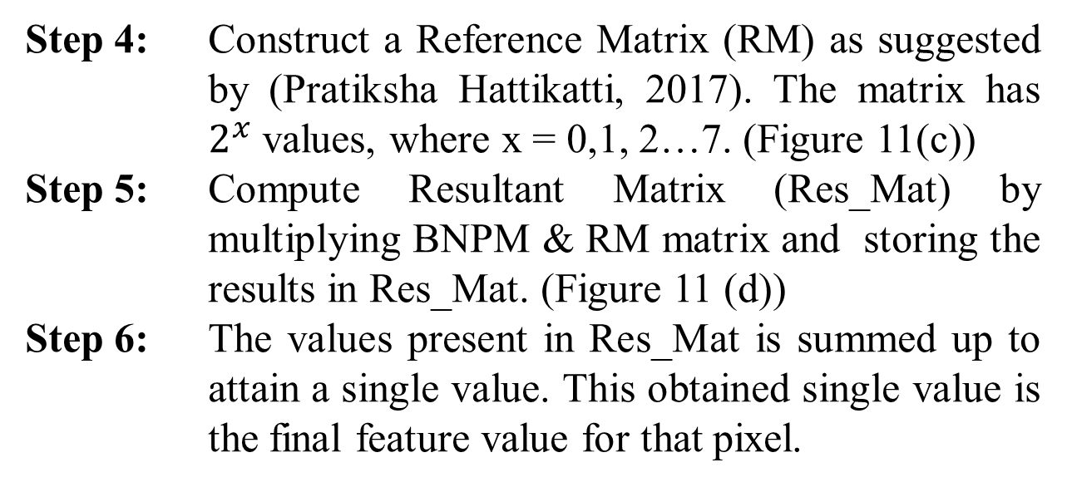
(Con’t…)
Step 4: Construct a Reference Matrix (RM) as suggested by (Pratiksha Hattikatti, 2017). The matrix has $2^{x}$ values, where x = 0,1, 2…7. (Figure 11(c))
Step 5: Compute Resultant Matrix (Res_Mat) by multiplying BNPM & RM matrix and storing the results in Res_Mat. (Figure 11 (d))
Step 6: The values present in Res_Mat is summed up to attain a single value. This obtained single value is the final feature value for that pixel.
Notes:
Local Feature:
Local features are particularly capable of attending to local image patterns or textures.

Slide 88
2.3 Deep feature extraction using DCNN
The Gabor features and RLBP features extracted previously is fed as input to the DCNN.
The combined input feature set is given to the Convolutional Layer.
Every layer follows a sequence with the Convolutional layer followed by ReLu, which then is followed by Pooling Layer.
The final result obtained from pooling layer represents the deep feature.
Notes:
Local Feature:
Local features are particularly capable of attending to local image patterns or textures.

Slide 89
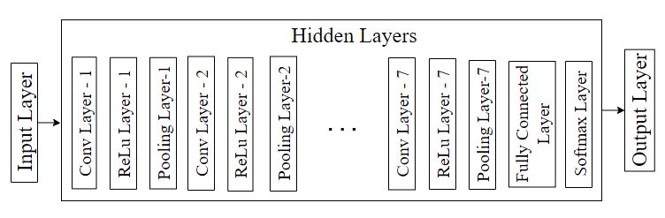
(Con’t…)
Figure 12. DCNN Model of the proposed system
Notes:
Local Feature:
Local features are particularly capable of attending to local image patterns or textures.

Slide 90
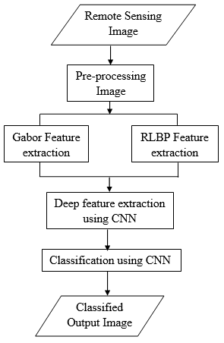
2.4 Combined Feature set
Figure 13.
Schematic view of the functionality of the proposed method
Notes:
Local Feature:
Local features are particularly capable of attending to local image patterns or textures.

Slide 91
2.5 Classification
The classification proceeds with the obtained feature subset.
The system performs classification with the CNN than applying any classifying techniques.
The DCNN contains 3 classification layers: Fully Connected (FC), Softmax and Classification Layer.
Notes:
Local Feature:
Local features are particularly capable of attending to local image patterns or textures.

Slide 92
EXPERIMENTAL RESULTS AND DISCUSSIONS

Slide 93
Table 10.
Specification of DCNN for the proposed system
Layer | Specification | Feature map size
Input Layer | Size: [7,7,3] | 7 x 7 x 3
Convolution Layer - 1 | Filt_Siz: [3 3], No_Filt: 20, Str: 1 x 1, Pool: 1 x 1 | 7 x 7 x 20
ReLu Layer - 1 | - | 7 x 7 x 20
Pooling Layer – 1 | Filt_Siz: [2 2], Str: 2 x 2, Pool: 1 x 1 | 4 x 4 x 20
Convolution Layer – 2 | Filt_Siz: [2 2], No_Filt: 40, Str: 1 x 1, Pool: 2 x 2 | 7 x 7 x 40
ReLu Layer – 2 | - | 7 x 7 x 40
Pooling Layer – 2 | Filt_Siz: [2 2], Str: 2 x 2, Pool: 1 x 1 | 4 x 4 x 40
Convolution Layer – 3 | Filt_Siz: [2 2], No_Filt: 40, Str: 1 x 1, Pool: 2 x 2 | 7 x 7 x 40
ReLu Layer – 3 | - | 7 x 7 x 40
Pooling Layer – 3 | Filt_Siz: [2 2], Str: 2 x 2, Pool: 1 x 1 | 4 x 4 x 40
Notes:
Local Feature:
Local features are particularly capable of attending to local image patterns or textures.

Slide 94
(Con’t…)
Layer | Specification | Feature map size
Convolution Layer – 4 | Filt_Siz: [2 2], No_Filt: 40, Str: 1 x 1, Pool: 2 x 2 | 7 x 7 x 40
ReLu Layer – 4 | - | 7 x 7 x 40
Pooling Layer – 4 | Filt_Siz: [2 2], Str: 2 x 2, Pool: 1 x 1 | 4 x 4 x 40
Convolution Layer – 5 | Filt_Siz: [2 2], No_Filt: 40, Str: 1 x 1, Pool: 2 x 2 | 7 x 7 x 40
ReLu Layer – 5 | - | 7 x 7 x 40
Pooling Layer – 5 | Filt_Siz: [2 2], Str: 2 x 2, Pool: 1 x 1 | 4 x 4 x 40
Convolution Layer – 6 | Filt_Siz: [2 2], No_Filt: 40, Str: 1 x 1, Pool: 2 x 2 | 7 x 7 x 40
ReLu Layer – 6 | - | 7 x 7 x 40
Pooling Layer – 6 | Filt_Siz: [2 2], Str: 2 x 2, Pool: 1 x 1 | 4 x 4 x 40
Notes:
Local Feature:
Local features are particularly capable of attending to local image patterns or textures.

Slide 95
(Con’t…)
Layer | Specification | Feature map size
Convolution Layer – 7 | Filt_Siz: [2 2], No_Filt: 40, Str: 1 x 1, Pool: 2 x 2 | 7 x 7 x 40
ReLu Layer – 7 | - | 7 x 7 x 40
Pooling Layer – 7 | Filt_Siz: [2 2], Str: 2 x 2, Pool: 1 x 1 | 4 x 4 x 40
FC Layer | - | 1 x 1 x 6
Softmax Layer | - | 1 x 1 x 6
Output Layer | - | 1 x 1 x 6
Notes:
Local Feature:
Local features are particularly capable of attending to local image patterns or textures.

Slide 96
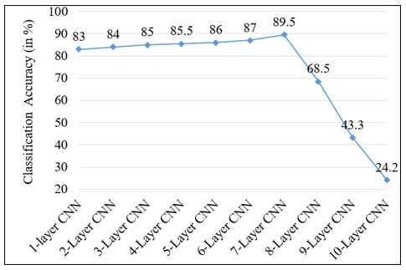
(Con’t…)
Figure 14. Classification Accuracies Vs CNN Layers
Notes:
Local Feature:
Local features are particularly capable of attending to local image patterns or textures.

Slide 97
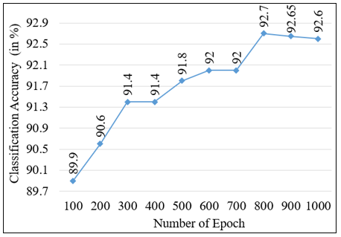
(Con’t…)
Figure 15. Classification Accuracies Vs Number of Epochs
Notes:
Local Feature:
Local features are particularly capable of attending to local image patterns or textures.

Slide 98
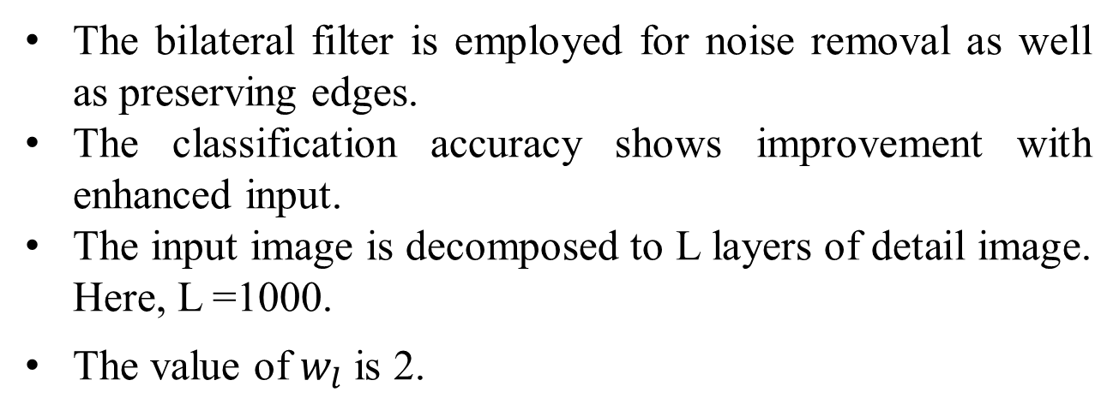
Image Enhancement:
The bilateral filter is employed for noise removal as well as preserving edges.
The classification accuracy shows improvement with enhanced input.
The input image is decomposed to L layers of detail image. Here, L =1000.
The value of $w_{l}$ is 2.
Feature Extraction:
The Gabor filter takes 0.2, 0.4, 0.6 MHz frequency and orientation, θ = 0, 45, 90, 135.
Notes:
Local Feature:
Local features are particularly capable of attending to local image patterns or textures.

Slide 99

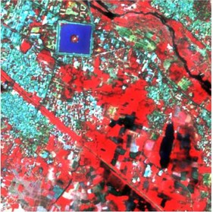
(a)
(b)
Figure 16.
Enhancement Results (a) Original LISS IV Madurai Image (b) Enhanced LISS IV Madurai Image
Notes:
Local Feature:
Local features are particularly capable of attending to local image patterns or textures.

Slide 100
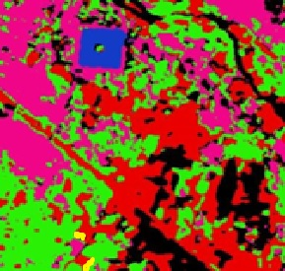
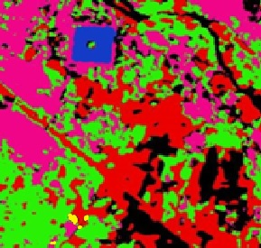
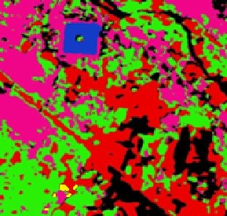
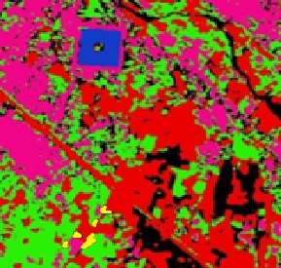

(a)
(b)
(c)
(d)
(e)
Figure 17.
Classified LISS IV images (a) Input LISS IV Image (b) Classified image with Deep features (c) Classified image with Deep features and Gabor (d) Classified image with Deep features and LBP (e) Classified image of the proposed method
Notes:
Local Feature:
Local features are particularly capable of attending to local image patterns or textures.

Slide 101

Table 11. Confusion Matrix for Madurai Image
Notes:
Local Feature:
Local features are particularly capable of attending to local image patterns or textures.

Slide 102

Table 12.
Classification accuracy of LISS IV Image based on different features
Notes:
Local Feature:
Local features are particularly capable of attending to local image patterns or textures.

Slide 103

Figure 18.
Classification Accuracies for LISS IV Image
Notes:
Local Feature:
Local features are particularly capable of attending to local image patterns or textures.

Slide 104

Figure 19.
Comparison of OA of the proposed method with other earlier methods
Notes:
Local Feature:
Local features are particularly capable of attending to local image patterns or textures.

Slide 105

Table 13.
Results of different methods and their classification accuracies for Madurai image
Notes:
Local Feature:
Local features are particularly capable of attending to local image patterns or textures.

Slide 106
OPTIMAL FEATURE SELECTION USING EVOLUTIONARY TECHNIQUES
Module - 3

Slide 107
DCNN is one of the successful neural networks for extracting features and classifying images, especially in the RS field.
But DCNN feature extraction methods result in large number of features.
Also, since the CNN architecture remains a black box, so selecting or reducing features is a tedious process.
This module presents a novel way of selecting only the most relevant deep features.
Notes:
Local Feature:
Local features are particularly capable of attending to local image patterns or textures.

Slide 108
The module proposes two entirely different ways of selecting efficient features.
Finally, we compare the results of both methods and suggest the best method.
The two methods are namely
Enhanced Selective Deep Feature Basket-based Firefly (ESDFBF) Algorithm.
Wrapper-based Random Search strategy with Mutual Information (WRSMI)
Notes:
Local Feature:
Local features are particularly capable of attending to local image patterns or textures.

Slide 109
Enhanced Selective Deep Feature
Basket-based Firefly (ESDFBF)
Notes:
Local Feature:
Local features are particularly capable of attending to local image patterns or textures.

Slide 110
Major contributions of the proposed method:
Selecting the necessary features from the feature maps generated by the activation function of DCNN.
Ensemble of two methods namely the feature aggregation and Firefly algorithm to bring out the fine features needed for classification.
Final Efficient feature selection for the classification of RS Images based on the Basket based feature selection method.
Notes:
Local Feature:
Local features are particularly capable of attending to local image patterns or textures.

Slide 111

Figure 20.
Architectural view of the Proposed Methodology
Notes:
Local Feature:
Local features are particularly capable of attending to local image patterns or textures.

Slide 112
3.1.1 1. Selective Deep Features (SDF) Algorithm
The multi-dimensional feature maps as the input, which are obtained from DCNN.
Every feature map represents the result of a filter applied on the input image matrix.
Each filter tries to bring out a feature from the image.
So, the maximum value in the feature map indicates that the particular position has some important feature.
Notes:
Local Feature:
Local features are particularly capable of attending to local image patterns or textures.

Slide 113
The input size of the feature maps is WxHxK (Where, WxH represents the feature map’s spatial resolution and K represents the number of feature maps).
The features are compared in a depth-wise manner and the maximum of which is found out.
The final features selected are of size w1xh1.
The feature set size is tremendously decreased thus leading to the improvement in the reduced running time.
Notes:
Local Feature:
Local features are particularly capable of attending to local image patterns or textures.

Slide 114
Algorithm: function SDF (deep_feat)
//Input: deep_feat, Feature Map from CNN of size W x H x K
//Output: selected_deep_feat, Selected features of size w1 x h1
Initialize max = 0
for i ← 1 to W
for j ←1 to H
for k ← 1 to K
if (deep_feat(i,j,k) > max)
max ← deep_feat(i,j,k)
end_if
selected_deep_feat(i,j) ← max
end_for
end_for
end_for
Return selected_deep_feat
Notes:
Local Feature:
Local features are particularly capable of attending to local image patterns or textures.

Slide 115
3.1.2 2. Enhanced Selective Deep Feature Firefly
(ESDFF) Algorithm
After the selection of the deep features, the Firefly-based algorithm namely ESDFF is applied to still bring out the efficient features from w1 x h1 features.
The Firefly algorithm is based on the glowing nature of the firefly. The firefly with lesser brightness moves towards the brighter firefly.
An initial population, Init_Pop of fireflies are randomly initialized.
The feature selection is done based on the brightness and the attractiveness of the fireflies.
Notes:
Local Feature:
Local features are particularly capable of attending to local image patterns or textures.

Slide 116
Initial Population
Create fireflies’ initial population randomly with binary values.
Each firefly is considered as a subset of features with the assumption that if it has value ‘1’ then it means the features are included and if the value is ‘0’ then those particular features are excluded.
The firefly is denoted as <Vi1, Vi2, Vi3, …, ViN> where, i = 1,2, 3, …, n and ‘n’ represents the firefly’s count.
Notes:
Local Feature:
Local features are particularly capable of attending to local image patterns or textures.

Slide 117

Calculate Fitness Function
Each firefly’s position is evaluated with the help of three basic classifiers.
The classifiers implemented are NB, MSVM and KNN classifier.
Notes:
Local Feature:
Local features are particularly capable of attending to local image patterns or textures.

Slide 118
Movement of Fireflies
Each firefly’s fitness is compared with the other fireflies to move less brighter fireflies towards more brighter fireflies.
i.e., The less bright fireflies have low fitness value and more brighter fireflies have high fitness values.
Notes:
Local Feature:
Local features are particularly capable of attending to local image patterns or textures.

Slide 119

To make such movement the position values are updated using distance ‘r’ and attractiveness ‘A’.
The $r_{ij}$ denotes the distance between $i^{th}$firefly and $j^{th}$firefly.
The attractiveness is calculated as follows,
Notes:
Local Feature:
Local features are particularly capable of attending to local image patterns or textures.

Slide 120

Assess the new position
Individually firefly’s new position is evaluated.
Based on the accuracy, the fitness function is recalculated for each firefly as follows,
Notes:
Local Feature:
Local features are particularly capable of attending to local image patterns or textures.

Slide 121
Rank and update
The firefly with the best fitness function value is selected as the best one and the corresponding features are considered as the best feature subset.
This step is continued until the desired number of features is obtained.
If the maximum iteration is reached, the algorithm is stopped with the best feature subset at that moment or else, from step 3 the process is continued again.
Notes:
Local Feature:
Local features are particularly capable of attending to local image patterns or textures.

Slide 122
3.1.3 3. Basket-based Feature Selection (BBFS) Algorithm
The proposed system uses three evaluators based on the three classifiers.
The algorithm is run using the three evaluators.
The execution of the ESDFF algorithm with different evaluators results in three feature set (FS).
FS_1 : Feature set obtained using NB classifier
FS_2 : Feature set obtained using KNN classifier
FS_3 : Feature set obtained using SVM classifier
Notes:
Local Feature:
Local features are particularly capable of attending to local image patterns or textures.

Slide 123
(Con’t…)
Let us consider three baskets for holding different feature sets.
The first basket holds value of More Efficient Feature (MEF), the second basket holds value of Efficient Feature (EF) and the third basket holds value of Least Efficient Feature (LEF).
Based on the FS_1, FS_2, FS_3, three baskets are filled.
Notes:
Local Feature:
Local features are particularly capable of attending to local image patterns or textures.

Slide 124

(Con’t…)
Notes:
Local Feature:
Local features are particularly capable of attending to local image patterns or textures.

Slide 125
(Con’t…)
Algorithm: function BBFS (FS1, FS2, FS3, N)
//Input: FS1, features obtained based on NB classifier, FS2, features obtained based on KNN classifier, FS3, features obtained based on SVM classifier, N represents the number of features to be selected
//Output: Final_fe, Final features selected
Calculate MEF, EF and LEF
B1 ← MEF
B2 ← EF
B3 ← LEF
if B1_size == N
Add all MEF features to B1
end-if
Notes:
Local Feature:
Local features are particularly capable of attending to local image patterns or textures.

Slide 126
(Con’t…)
while B1_size != N
if (B1_Size < N)
n = N – B1_size
if (B2_size == n)
add EF to B1
else-if (B2_size > n)
Calculate Idx using MRMR algorithm for all EF
Add top ‘n’ features to B1
else
Add all EF features to B1
n = N – B1_size
Calculate Idx for all LEF features
Add top ‘n’ features to B1
end-if
Notes:
Local Feature:
Local features are particularly capable of attending to local image patterns or textures.

Slide 127
(Con’t…)
else
n = N – B1_size
Calculate Idx for all MEF features
Add top ‘n’ features to B1
end-if
end-while
Return Final_fe = B1
Notes:
Local Feature:
Local features are particularly capable of attending to local image patterns or textures.

Slide 128
Wrapper-based Random Search strategy with Mutual Information (WRSMI)
Notes:
Local Feature:
Local features are particularly capable of attending to local image patterns or textures.

Slide 129
Major contributions of the proposed method:
The system proposes another new way of selecting features which works based on random search method.
The selection is wrapper-based that works using a randomized search strategy and it is referred as “Wrapper-Based Random Search strategy with Mutual Information (WRSMI).
The process is done in an orderly manner.
Notes:
Local Feature:
Local features are particularly capable of attending to local image patterns or textures.

Slide 130

Figure 21. Block diagram of WRSMI method
Notes:
Local Feature:
Local features are particularly capable of attending to local image patterns or textures.

Slide 131
3.2.1 SDF Algorithm
The proposed method considers the multi-dimensional feature maps as the input, which are obtained from DCNN.
Every feature map represents the result of a filter applied on the input image matrix.
Each filter tries to bring out a feature from the image.
So, the maximum value in the feature map indicates that the particular position has some important feature.
Notes:
Local Feature:
Local features are particularly capable of attending to local image patterns or textures.

Slide 132
The input size of the feature maps is WxHxK (Where, WxH represents the feature map’s spatial resolution and K represents the number of feature maps).
The features are compared in a depth-wise manner and the maximum of which is found out.
The final features selected are of size w1xh1.
The feature set size is tremendously decreased thus leading to the improvement in the reduced running time.
Notes:
Local Feature:
Local features are particularly capable of attending to local image patterns or textures.

Slide 133
(Con’t…)
Algorithm: function SDF (deep_feat)
//Input: deep_feat, Feature Map from CNN of size W x H x K
//Output: selected_deep_feat, Selected features of size w1 x h1
Initialize max = 0
for i ← 1 to W
for j ←1 to H
for k ← 1 to K
if (deep_feat(i,j,k) > max)
max ← deep_feat(i,j,k)
end_if
selected_deep_feat(i,j) ← max
end_for
end_for
end_for
Return selected_deep_feat
Notes:
Local Feature:
Local features are particularly capable of attending to local image patterns or textures.

Slide 134
3.2.2 Randomized Selection
Algorithm: randomized selection (F)
//Input: Feature which are extracted, F
//Output: Selected feature, G
Initialize n=1, i=1;
Compute feature group size, g = (F/2);
Add random ‘n’ number of features to set, G;
while ((sizeof (G) < g) or (i==100))
Evaluate the accuracy, acc of G using learner;
X = G; Then, add ‘n’ features from F to X;
Evaluate the accuracy, new_acc of X;
Notes:
Local Feature:
Local features are particularly capable of attending to local image patterns or textures.

Slide 135
if acc < new_acc
G = X;
else
G remains the same;
end-if
i=i+1
end-while
Return final selected features, G
Notes:
Local Feature:
Local features are particularly capable of attending to local image patterns or textures.

Slide 136

3.2.3 Warm Start
The process evaluates the feature set, G using the Mutual Information (MI).
The features with larger MI values are considered the best features.
The MI of two random variables is calculated by entropy and it measures the uncertainty of random variables and scales the total information shared by them effectively
Notes:
Local Feature:
Local features are particularly capable of attending to local image patterns or textures.

Slide 137
P(x, y) is the joint probability distribution function of X and Y.
Let X is a discrete random variable and Y is the Class label.
The MI value is calculated for all the features in set G and the ‘m’ number of features with larger MI values is placed in another set, E.
Notes:
Local Feature:
Local features are particularly capable of attending to local image patterns or textures.

Slide 138
3.2.4 Cool Down
Algorithm: cool_down(E, F)
//Input : Selected feature set, E and full feature set, F
//Output : Final feature set, E_select
Calculate MI for all the features in the set, F – E.
Fea_order = Arrange the features in descending order based on MI values.
E1 = Select ‘p’ number of features from Fea_order
X = E
i = 1
Notes:
Local Feature:
Local features are particularly capable of attending to local image patterns or textures.

Slide 139
while (i<p)
Evaluate the accuracy, acc of X using learner.
E_select = Add i^{th} features from E1 to X;
Evaluate the accuracy, new_acc of E_select;
if acc < new_acc
X = E_select;
else
X remains the same;
end-if
i = i +1;
end-while
Return final selected features, E_select
Notes:
Local Feature:
Local features are particularly capable of attending to local image patterns or textures.

Slide 140
EXPERIMENTAL RESULTS AND DISCUSSIONS
Module - 3

Slide 141
EXPERIMENTAL RESULTS OF ESDFBF METHOD

Slide 142
The system uses three classifiers for finding the fitness function.
The classifiers are namely NB, MSVM & KNN, and the methods are referred as ESDFF-NB, ESDFF-MSVM & ESDFF-KNN respectively.
The features obtained from ESDFF-NB, ESDFF-MSVM & ESDFF-KNN are FS_1, FS_2 and FS_3 respectively.
The feature selection process is implemented as three steps with the help of algorithms namely SDF, ESDFF and BBFS.
Notes:
Local Feature:
Local features are particularly capable of attending to local image patterns or textures.

Slide 143
Initially, the SDF algorithm is executed and the feature maps of size 4x4x20 is reduces to 4x4.
Table 14. Parameters used by ESDFF algorithm
Name of the Parameter | Value
Population size | 30
α | 0.5
γ | 1
Max_itr | 40

Slide 144

Figure 22. Number of features Vs Classification accuracy

Slide 145

Figure 23. Number of Iteration Vs Classification Accuracy

Slide 146

Figure 24.
Classified output results of LISS IV Madurai image

Slide 147

(Con’t…)
Table 15. Confusion Matrix for Madurai Image
Notes:
Local Feature:
Local features are particularly capable of attending to local image patterns or textures.

Slide 148

Figure 25. Comparison of classification accuracy

Slide 149

Figure 26.
Comparison of classification result of ESDFBF method with other methods for LISS IV Image (a) EBCS, (b) ACO, (c) BGWO, (d) GA, (e) PSO and (f) ESDFBF

Slide 150

Figure 27.
Comparison of ESDFBF classification accuracy with other methods for LISS IV image

Slide 151
EXPERIMENTAL RESULTS OF WRSMI METHOD

Slide 152

The proposed system performs three steps for feature selection systematically.
The first step implemented is Randomized selection.
Initially, the feature group size, g is computed using the following equation.
Our proposed system selects the ‘g’ number of features randomly for feature selection from the set, F.
The learner implemented here is a gradient boosting tree.

Slide 153

The second step of the proposed system is Warm start.
Here, the MI value is calculated for all the features in set G using the below equation and the ‘m’ number of features with larger MI values is placed in another set, E.

Slide 154
The third step implemented is cool down.
The cool down process is implemented to find out the remaining useful features in the feature set, F.
The ‘m’ value is assigned to ‘p’ also. Among ‘p’ features some features are found to be relevant and they are added to the final feature set, E_select.
Finally, the system results in selecting 50% of best features from the feature set, F.

Slide 155
Figure 28. Classified images using WRSMI method

Slide 156

Table 16. Confusion Matrix for Madurai Image
Notes:
Local Feature:
Local features are particularly capable of attending to local image patterns or textures.

Slide 157
Comparison of ESDFBF and WRSMI

Slide 158

Figure 29.
Classification accuracy of ESDFBF and WRSMI method

Slide 159
Comparison of ESDFBF and WRSMI
The classification accuracies of the dataset when implemented using two methods are 95% and 94.8% for ESDFBF and WRSMI, respectively.
From the outcome, it is understood that ESDFBF outperforms the classification accuracy of WRSMI method.
Notes:
Local Feature:
Local features are particularly capable of attending to local image patterns or textures.

Slide 160
Comparison of EOTFDF, TSTF-CNN, ESDFBF and WRSMI

Slide 161

Figure 30. Comparison of correctly classified pixels
Number of samples considered for analysis:
Urban: 131, Vegetation: 216, Water Body: 56,
Tank: 10, Waste Land: 59, Saline Land: 4

Slide 162

Figure 31. Comparison of classification Accuracy

Slide 163
By experimentally analyzing the results, based on the correctly classified classes it can be interpreted that the TSTF-CNN method with ESDFBF method performs well for classes like Urban, Vegetation, Tank.
On the other hand, TSTF-CNN with WRSMI performs well for classes like Water body and Saline Land.
Whereas both the method performs equally good for Waste Land class.
Notes:
Local Feature:
Local features are particularly capable of attending to local image patterns or textures.

Slide 164
EXPERIMENTAL ANALYSIS OF THE PROPOSED SYSTEM WITH KANYAKUMARI DATASET

Slide 165
Dataset used is Kanyakumari Image from Sentinel 2A, which is part of Copernicus Sentinel-2 mission.
The ground truth image is taken from the global land cover map released by ESRI (Environmental System Research Institute) by European Space Agency.
Land Cover Details
Water
Trees
Grass
Flooded Vegetation
Crops
Shrub
Build area
Notes:
Local Feature:
Local features are particularly capable of attending to local image patterns or textures.

Slide 166

Input Image:
Figure 32. Sentinel 2A Kanyakumari image
Latitude: 8°12'28" N to 8°35’43“ N Longitude: 77°12'7" E to 77°36'49" E
Notes:
Local Feature:
Local features are particularly capable of attending to local image patterns or textures.

Slide 167
Ground Truth Image:
Figure 33.
Ground truth image of Kanyakumari Region
Notes:
Local Feature:
Local features are particularly capable of attending to local image patterns or textures.

Slide 168
EXPERIMENTAL RESULTS

Slide 169
Experimental results of EOTFDF method

Slide 170


Figure 34.
Classified Kanyakumari image using EOTFDF method
Notes:
Local Feature:
Local features are particularly capable of attending to local image patterns or textures.

Slide 171

Table 17. Confusion matrix of EOTFDF method
Notes:
Local Feature:
Local features are particularly capable of attending to local image patterns or textures.

Slide 172
Experimental results of TSTF-CNN method

Slide 173

Figure 35.
Classification result of TSTF-CNN
Notes:
Local Feature:
Local features are particularly capable of attending to local image patterns or textures.

Slide 174

Table 18. Confusion matrix of EOTFDF method
Notes:
Local Feature:
Local features are particularly capable of attending to local image patterns or textures.

Slide 175
Experimental results of ESDFBF method

Slide 176

Figure 36.
Classified Kanyakumari image using ESDFBF Method
Notes:
Local Feature:
Local features are particularly capable of attending to local image patterns or textures.

Slide 177

Table 19. Confusion matrix of ESDFBF method
Notes:
Local Feature:
Local features are particularly capable of attending to local image patterns or textures.

Slide 178
Experimental results of WRSMI method

Slide 179

Figure 37. Classified Kanyakumari image using WRSMI method
Notes:
Local Feature:
Local features are particularly capable of attending to local image patterns or textures.

Slide 180

Table 20. Confusion matrix of WRSMI method
Notes:
Local Feature:
Local features are particularly capable of attending to local image patterns or textures.

Slide 181

Figure 38. Comparison of correctly classified pixels
Notes:
Local Feature:
Local features are particularly capable of attending to local image patterns or textures.

Slide 182

Figure 39. Comparison of correctly classified pixels
Notes:
Local Feature:
Local features are particularly capable of attending to local image patterns or textures.

Slide 183
Conclusion
LULC classification is a very tedious process because of its limitations such as the existence of more complicated features in remote sensing images, identification of varying textural surfaces of different land areas, and so on.
Several approaches are proposed to perform efficient classification amidst these limitations.
The classification accuracies obtained are 92.01%, 94.7%, 96.2% and 94.8% for EOTFDF, TSTF-CNN, ESDFBF, and WRSMI methods respectively.
Notes:
Local Feature:
Local features are particularly capable of attending to local image patterns or textures.

Slide 184
Based on the experimental results such as number of correctly classified classes and classification accuracies, the thesis concludes that the TSTF-CNN feature extraction method and ESDFBF feature selection method is the most effective method.
In future, if any classification is done for specific class the user may opt for TSTF-CNN method with ESDFBF method for classes like Urban, Vegetation, Tank.
TSTF-CNN with WRSMI performs well for classes like Water body and Saline Land.
Notes:
Local Feature:
Local features are particularly capable of attending to local image patterns or textures.

Slide 185
REFERENCES
Vignesh T, Thyagharajan KK, Murugan D, Sakthivel M, Pushparaj S (2016). A novel multiple unsupervised algorithm for land use/land cover classification. Indian J Sci Technol., Vol. 9, no. 42, pp. 1–12. doi:10.17485/ijst/2016/v9i42/99682
Amit Kumar Verma, Garg P.K., Hari Prasad K.S, Dadhwal V.K (2016). Classification Of LISS IV Imagery using Decision Tree Methods. The International Archives of the Photogrammetry, Remote Sensing and Spatial Information Sciences, Vol. XLI-B8. doi: 10.5194/isprs-archives-XLI-B8-1061-2016
Mitkari K.V, Arora M.K and Tiwari R.K (2017). Extraction of Glacial Lakes in Gangotri Glacier Using Object-Based Image Analysis. IEEE Journal of Selected Topics in Applied Earth Observations and Remote Sensing, Vol. 10, no. 12, pp. 5275-5283, doi: 10.1109/JSTARS.2017.2727506.

Slide 186
Prakash P.S, Soumya K.D and Bharath H.A (2018). Urban building extraction using satellite imagery through Machine Learning, 2018 IEEE Symposium Series on Computational Intelligence (SSCI), pp. 1670-1675, doi: 10.1109/SSCI.2018.8628919.
Biswajit Mondal, Ashis Kumar Saha & Anirban Roy (2019). Mapping mangroves using LISS-IV and Hyperion data in part of the Indian Sundarban, International Journal of Remote Sensing, Vol. 40, no. 24, DOI: 10.1080/01431161.2019.1630784.
Jovish John, Bindu G, Srimuruganandam B, Abhinav Wadhwa & Poornima Rajan (2020). Land use/land cover and land surface temperature analysis in Wayanad district, India, using satellite imagery, Annals of GIS, Vol. 26, no.4, pp. 343-360, DOI: 10.1080/19475683.2020.1733662.

Slide 187
Vignesh T, Thyagharajan K.K, Jeyavathana R.B and Kanimozhi K.V (2021). Land Use and Land Cover Classification Using Recurrent Neural Networks with Shared Layered Architecture. 2021 International Conference on Computer Communication and Informatics (ICCCI), pp. 1-6, doi: 10.1109/ICCCI50826.2021.9402638.
Diksha Naik, Apurva Sawarbandhe, Barkha Deogade, Pooja Dupare, Pooja Khodke, Vandana S. Choubey (2021). An Implementation of Satellite Image Classification and Analysis using Machine Learning with ISRO LISS IV, International Journal of Computational and Electronics Aspects in Engineering Vol. 2, no. 2, pp. 1 – 9. https://doi.org/10.26706/ijceae.2.2.20210404

Slide 188
Krishna Kumar Perikamana, Krishnachandran Balakrishnan, Pratyush Tripathy (2021). A CNN based method for Sub-pixel Urban Land Cover Classication using Landsat-5 TM and Resourcesat-1 LISS-IV Imagery. Computer Vision and Pattern Recognition. https://doi.org/10.48550/arXiv.2112.08841
Tanya Jain, MOHD Jawed Khan, Shubham Pandey, Shivam Mishra, Shubham Yadav (2022). Satellite Image Classification and Analysis using Machine Learning with ISRO LISS IV, International Research Journal of Engineering and Technology (IRJET), Vol. 09, no. 5, pp. 1479–1487.
Fatyanosa, TN & Aritsugi, M (2020), ‘Effects of the number of hyperparameters on the performance of GA-CNN’, 2020 IEEE/ACM International Conference on Big Data Computing, Applications and Technologies (BDCAT), pp. 144-153, DOI: 10.1109/BDCAT50828.2020. 00016

Slide 189
Pratiksha Hattikatti (2017). Texture based interstitial lung disease detection using convolutional neural network. 2017 international conference on big data, iot and data science (Bid) Pune, India, pp 18–22, Vishwakarma Institute of Technology.
Zhouhan Lin, Yushi Chen, Xing Zhao & Gang Wang (2013). Spectral-spatial classification of hyperspectral image using autoencoders, 9th International Conference on Information, Communications & Signal Processing (ICICS), DOI: 10.1109/ICICS.2013.6782778.
Chen, Y, Lin, Z, Zhao, X, Wang, G & Gu, Y (2014). ‘Deep learning-based classification of hyperspectral data’, IEEE J. Sel. Topics Appl. Earth Observ. Remote Sens., vol. 7, no. 6, pp. 2094-2107.

Slide 190
Yue, J, Zhao, W, Mao, S & Liu, H (2015). ‘Spectral–spatial classification of hyperspectral images using deep convolutional neural networks’, Remote Sens. Lett., vol. 6, no. 6, pp. 468-477.
Aptoula, E, Ozdemir, MC & Yanikoglu, B (2016). ‘Deep learning with attribute profiles for hyperspectral image classification’, IEEE Geosci. Remote Sens. Lett., vol. 13, no. 12, pp. 1970-1974.
Yushi Chen, Lin Zhu, Pedram Ghamisi, Xiuping Jia, Guoyu Li & Liang Tang (2017). ‘Hyperspectral images classification with gabor filtering and convolutional neural network’, IEEE Geoscience and Remote Sensing Letters, vol. 14, no. 12, pp. 2355-2359, DOI: 10.1109/LGRS.2017.2764915.

Slide 191
Felix Juefei-Xu, Vishnu Naresh Boddeti & Marios Savvides (2017). ‘Local binary convolutional neural networks’, IEEE Conference on Computer Vision and Pattern Recognition, pp. 4284-4293, DOI: 10.1109/CVPR. 2017.456.
Zhou, Z, Li, S & Shao, Y (2018). ‘Crops classification from sentinel-2A multi-spectral remote sensing images based on convolutional neural networks’, IGARSS 2018 - 2018 IEEE International Geoscience and Remote Sensing Symposium, pp. 5300-5303, DOI : 10.1109/IGARSS. 2018.8518860.
Jiang, J, Feng, X, Liu, F, Xu, Y & Huang, H (2019). ‘Multi-spectral RGB-NIR image classification using double-channel CNN’, IEEE Access, vol. 7, pp. 20607-20613, DOI: 10.1109/ACCESS.2019.2896128.

Slide 192
Shengjie Liu, Qian Shi & Liangpei Zhang (2020). ‘Few-shot hyperspectral image classification with unknown classes using multitask deep learning’, IEEE Transactions on Geoscience and Remote Sensing, vol. 59, no. 6, pp. 5085-5102, DOI: 10.1109/TGRS.2020.3018879.
Akrem Sellami & Salvatore Tabbone (2022). ‘Deep neural networks-based relevant latent representation learning for hyperspectral image classification’, Pattern recognition, vol. 121

Slide 193
Course Work Completed
S.No | Course Code | Course Name | Credits | Core /Elective | Grade Obtained (Grade Point)
1 | 15MCC16 | Data Mining Techniques | 4 | Elective | A (8)
2 | 15MI102 | Soft Computing Techniques | 4 | Core | A+ (9)
3 | 15MCC10 | Image Processing and Analysis | 3 | Elective | A (8)
4 | 15MIC13 | Web Mining and Information Retrieval | 3 | Elective | A+ (9)

Slide 194
List of Publications

Slide 195
Rajesh, S; Gladima Nisia, T; Arivazhagan, S & Abisekaraj, R 2020, “Land Cover/Land Use Mapping of LISS IV Imagery Using Object-Based Convolutional Neural Network with Deep Features”, Journal of the Indian Society of Remote Sensing, Vol. 48, no. 1, pp. 145 – 154. (Impact Factor: 1.8)
Gladima Nisia, T & Rajesh, S 2022, "Ensemble of features for efficient classification of high-resolution remote sensing image", European Journal of Remote Sensing, Vol.55, no. 1, pp.326-337. (Impact Factor: 3.1).
DOI:https://doi.org/10.1080/22797254.2022.2075794.
Gladima Nisia, T & Rajesh, S 2022, “Enhanced Feature Selection method using Wrapper-based Random Search strategy and Mutual Information for Remote Sensing Image Classification”, Comptes rendus de l'Academie bulgare des Sciences, Vol. 75, no. 7, pp. 1037-1044. Impact Factor: 0.3.

Slide 196
THANK YOU

